Slide 1
CPBP 8306: Clustering algorithms
Stevenson Science & Engineering Library
Joshua Borycz

Slide 2
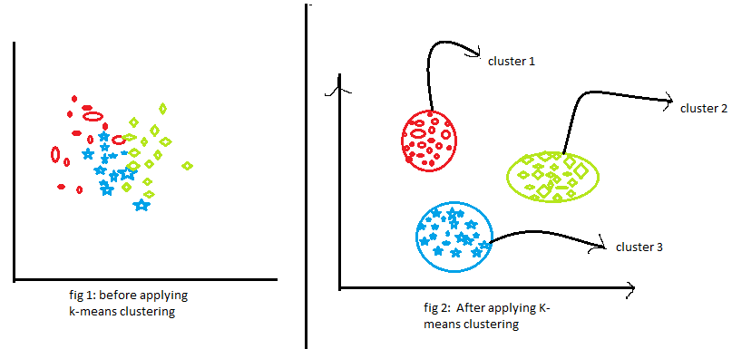
K-means clustering
K-means clustering is an unsupervised machine learning algorithm that is used to group data points into a specified number of clusters (k). The algorithm works by iteratively assigning data points to the nearest cluster center and then updating the cluster centers to be the mean of the data points in that cluster. This process continues until the cluster assignments no longer change.
The goal of k-means clustering is to group similar data points together, with the data points in each cluster being as similar as possible to each other and as different as possible from the data points in the other clusters. This can be useful for tasks like customer segmentation, image compression, and anomaly detection.
https://www.analyticsvidhya.com/blog/2020/10/a-simple-explanation-of-k-means-clustering/
Notes:
Note: We have only restructured the data and removed non data content (e.g., title and descriptions)
The data still contains the same number of cells, but now facilitates machine analysis
Good practice to only include data in your data file and all other contextual information should be addressed in other locations (e.g., ReadMe, data dictionary)

Slide 3
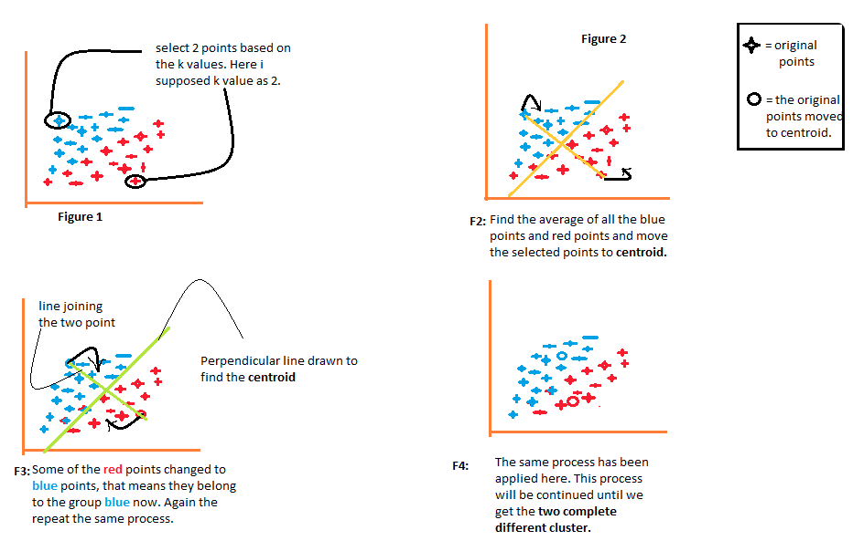
K-means clustering
The main steps in k-means clustering are:
Specify the number of clusters (k) to create.
Initialize k cluster centroids (the center points of the clusters).
Assign each data point to the nearest cluster centroid.
Update the cluster centroids to be the mean of the data points in each cluster.
Repeat steps 3 and 4 until the cluster assignments no longer change.
Notes:
Note: We have only restructured the data and removed non data content (e.g., title and descriptions)
The data still contains the same number of cells, but now facilitates machine analysis
Good practice to only include data in your data file and all other contextual information should be addressed in other locations (e.g., ReadMe, data dictionary)

Slide 4
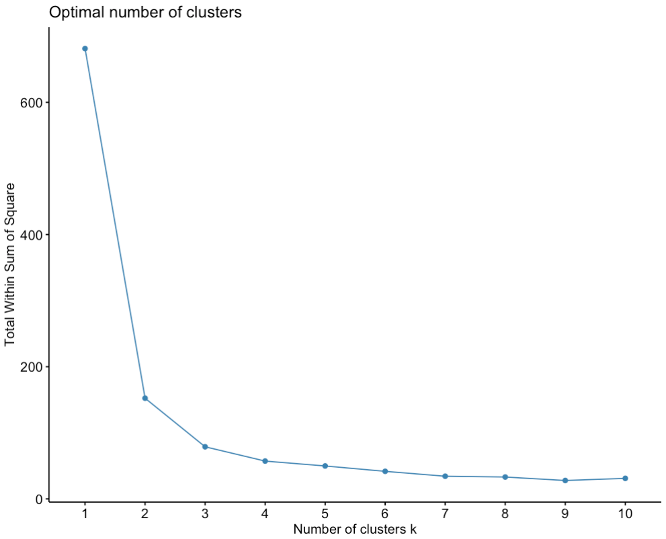
Choosing K: Elbow method
The total Within Cluster Sum of Squares (WCSS) is minimized by the k-means algorithm, as it tries to find the cluster assignments that result in the smallest sum of squared distances between data points and their assigned cluster centroids.
A lower WCSS value indicates that the data points are well-clustered, as they are closer to their assigned cluster centroids. The WCSS is commonly used to determine the optimal number of clusters (k) by examining the "elbow" in the plot of WCSS versus the number of clusters.
Notes:
Note: We have only restructured the data and removed non data content (e.g., title and descriptions)
The data still contains the same number of cells, but now facilitates machine analysis
Good practice to only include data in your data file and all other contextual information should be addressed in other locations (e.g., ReadMe, data dictionary)

Slide 5
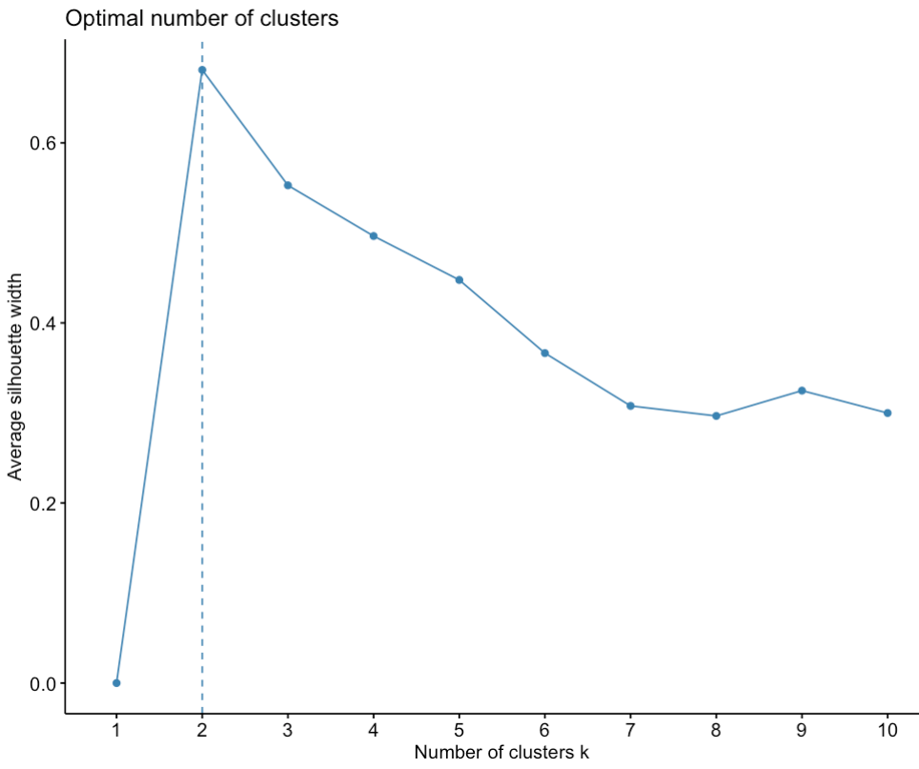
Choosing K: Silhouette
The silhouette value for a data point is calculated as:
s = (b - a) / max(a, b)
Where a is the average distance between the data point and all other data points in the same cluster, and b is the average distance between the data point and all data points in the nearest neighboring cluster.
The silhouette value ranges from -1 to 1, with the following interpretations:
1 indicates that the data point is well-matched to its own cluster and poorly-matched to neighboring clusters.
0 indicates that the data point is on the border of two clusters.
-1 indicates that the data point may have been assigned to the wrong cluster.
Notes:
Note: We have only restructured the data and removed non data content (e.g., title and descriptions)
The data still contains the same number of cells, but now facilitates machine analysis
Good practice to only include data in your data file and all other contextual information should be addressed in other locations (e.g., ReadMe, data dictionary)

Slide 6
Choosing K: Gap statistic
The gap statistic is defined as:
Gap(k) = E_n[log(W_k)] - log(W_k)
E_n[log(W_k)] is the expected value of the logarithm of the within-cluster dispersion measure for the reference distribution, and
log(W_k) is the logarithm of the actual within-cluster dispersion measure for the observed data.
The optimal number of clusters k is the value that maximizes the gap statistic, as this indicates the value of k where the observed within-cluster dispersion is furthest from the expected within-cluster dispersion under the null (uniform) reference distribution.
E_n[log(W_k)]
log(W_k)
Notes:
Note: We have only restructured the data and removed non data content (e.g., title and descriptions)
The data still contains the same number of cells, but now facilitates machine analysis
Good practice to only include data in your data file and all other contextual information should be addressed in other locations (e.g., ReadMe, data dictionary)

Slide 7
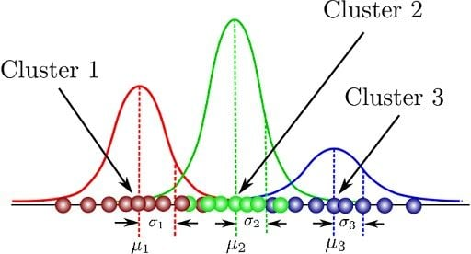
Gaussian Mixture Model (GMM)
Gaussian Mixture Model (GMM) Clustering is a type of unsupervised learning algorithm that is used to group data points into clusters. It is a model-based clustering method, where the data is assumed to be generated from a mixture of Gaussian (normal) distributions.
The key steps in GMM clustering are:
Assume the data is generated from a mixture of Gaussian distributions, each representing a cluster.
Estimate the parameters (mean, covariance, and mixing proportion) of each Gaussian component in the mixture.
Assign data points to the cluster (Gaussian component) that has the highest posterior probability of generating that data point.
Notes:
Note: We have only restructured the data and removed non data content (e.g., title and descriptions)
The data still contains the same number of cells, but now facilitates machine analysis
Good practice to only include data in your data file and all other contextual information should be addressed in other locations (e.g., ReadMe, data dictionary)

Slide 8
Gaussian Mixture Model (GMM)
Uses an iterative Expectation-Maximization (EM) approach to estimate the model parameters and assign data points to clusters. The number of clusters (Gaussian components) is typically determined using a model selection criterion, such as the Bayesian Information Criterion (BIC).
Captures more complex cluster shapes and structures compared to methods like k-means clustering, which assumes spherical, equally-sized clusters. It is particularly useful when the underlying data has a complex, non-spherical distribution.
Notes:
Note: We have only restructured the data and removed non data content (e.g., title and descriptions)
The data still contains the same number of cells, but now facilitates machine analysis
Good practice to only include data in your data file and all other contextual information should be addressed in other locations (e.g., ReadMe, data dictionary)

Slide 9
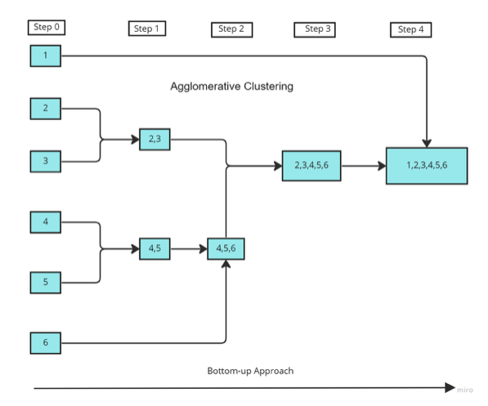
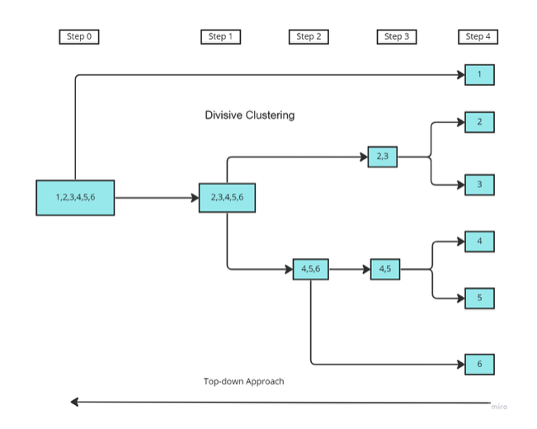
Hierarchical clustering
Unsupervised learning algorithm used to group data points into clusters. It creates a hierarchy of clusters, where smaller clusters are gradually merged into larger clusters (agglomerative) or larger clusters are recursively split into smaller clusters (divisive).
Agglomerative Clustering: Starts with each data point as its own cluster and then iteratively merges the closest clusters until a single cluster remains. The result is a dendrogram, a tree-like diagram that illustrates the hierarchical relationships between the clusters. The optimal number of clusters can be determined by cutting the dendrogram at a specific height.
Divisive Clustering: Starts with all data points in a single cluster and then recursively splits the clusters until each data point is in its own cluster. The splitting is typically done by finding the cluster with the largest diameter and dividing it into two new clusters.
Notes:
Note: We have only restructured the data and removed non data content (e.g., title and descriptions)
The data still contains the same number of cells, but now facilitates machine analysis
Good practice to only include data in your data file and all other contextual information should be addressed in other locations (e.g., ReadMe, data dictionary)

Slide 10
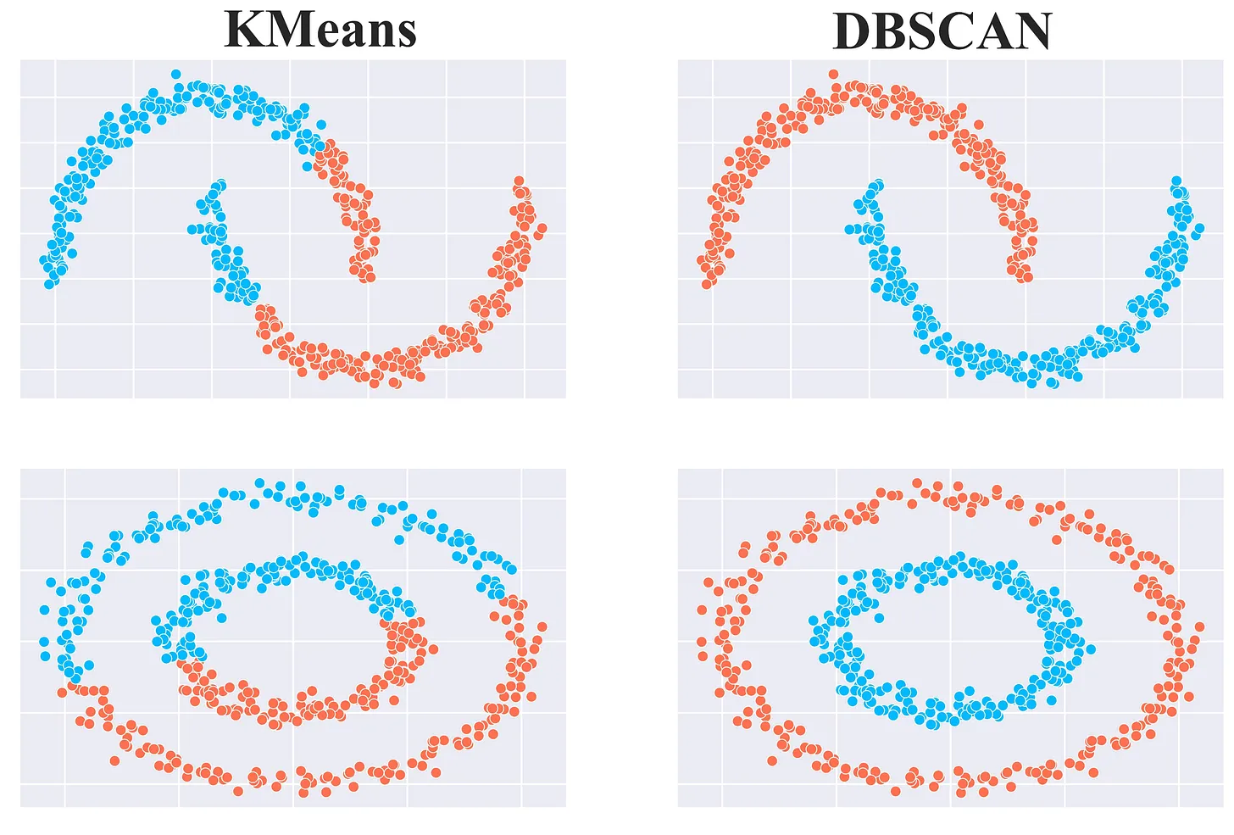
DBSCAN Clustering
DBSCAN (Density-Based Spatial Clustering of Applications with Noise) is method where clusters are defined as areas of high density separated by areas of low density.
The key aspects of DBSCAN are:
Identifies clusters based on the density of data points in a given area, rather than the distance between data points.
Two input parameters: eps (the max distance between two data points in same neighborhood) and minPts (the min number of data points required to form a dense region).
Data points into three categories: core points (data points with at least minPts neighbors within eps distance), border points (data points with fewer than minPts neighbors within eps distance but are still part of a cluster), and noise points (data points that do not belong to any cluster).
Automatically detects the number of clusters in the data, without requiring the user to specify the number of clusters in advance.
Notes:
Note: We have only restructured the data and removed non data content (e.g., title and descriptions)
The data still contains the same number of cells, but now facilitates machine analysis
Good practice to only include data in your data file and all other contextual information should be addressed in other locations (e.g., ReadMe, data dictionary)

